Slide 1
Lab 4
Accessing Secondary Data with CartoDB

Slide 2
What You Will Learn How To
Access a wide variety of geographic data sources
Perform queries on data
Digitize your own data
Screen-scape from web pages
Georeference locations
Publish live maps on your portfolio web site

Slide 3
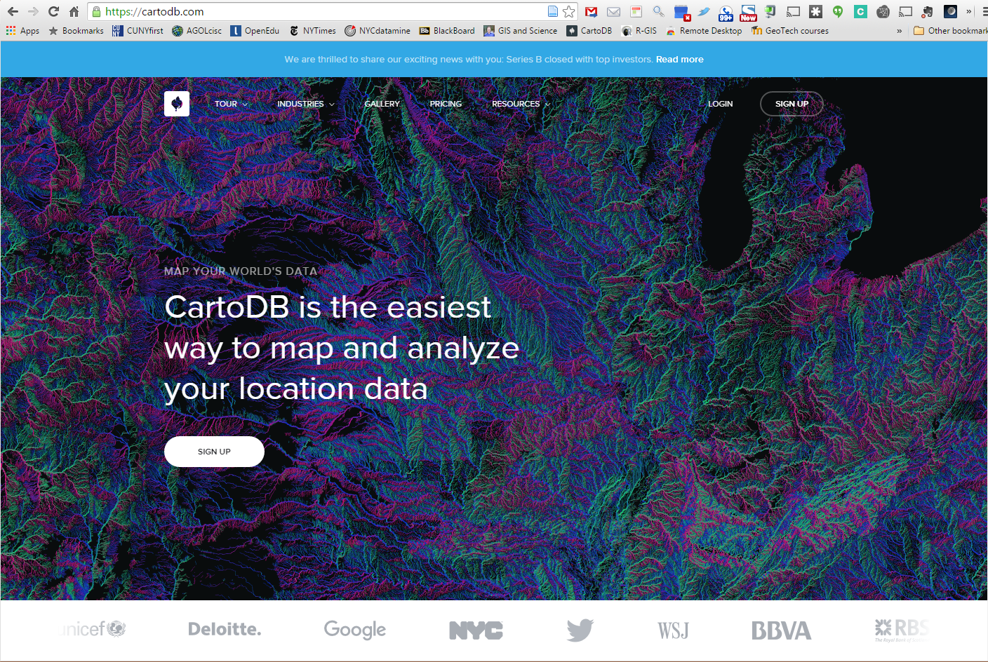
cartodb.com

Slide 4
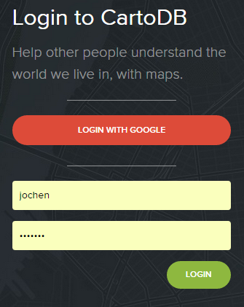
Your Account
Vizzuality is a local (Brooklyn-based) company
Create a free account and sign in to be prompted by the CartoDB dashboard
Initially, this dashboard will be empty and you will start by creating a new map

Slide 5
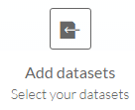
Add data
Do not create a new empty map !
Add datasets instead
You have five options:
Search a library of datasets hosted by CartoDB
Connect to an external dataset
Work with data that you have uploaded to your CartoDB account earlier
Access data that others have shared with you
Browse the library of datasets hosted by CartoDB

Slide 6
Populated Places
We start by searching for a hosted dataset called ‘Populated places’ and get
Mark the first one and click

Slide 7
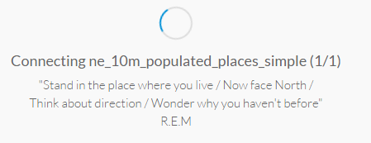
Populated Places
We start by searching for a hosted dataset called ‘Populated places’ and get
Mark the first one and click

Slide 8
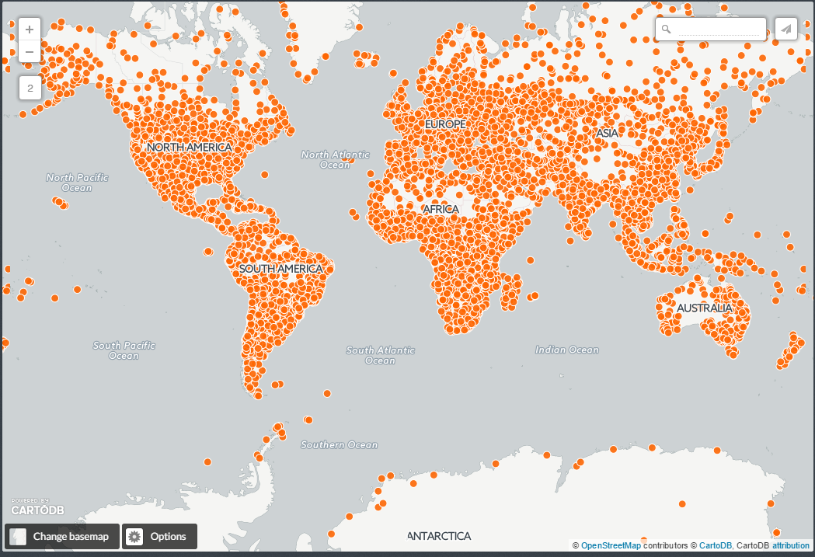
Your First CartoDB Map
CartoDB goes off, reads the data and creates a first map using a default visualization - which arguably is quite ugly

Slide 9
CartoDB User Interface
For the remainder of this lab – we will be dealing with the various components of CartoDB
Map versus data
Customizing maps
Looking under the hood: this is actually a vertical bar that was turned by 90° on this slide to make it fit here

Slide 10
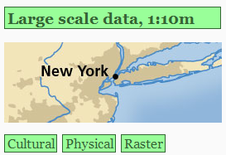
1.
http://www.naturalearthdata.com/
“Large” scale cultural data
Populated Places
Right-click and copy link address, paste into cartoDB window and

Slide 11
CartoDB is PostGIS-based
In PostGIS, everything is a table
Click on DataView to see the table have a look at it
Rename it to by double-clicking and replace ‘Untitled Map’ with ‘cities’; then switch back to Map View

Slide 12
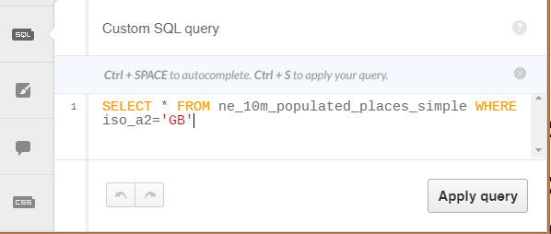
Apply a Filter
This map is way too crowded
You interact with your database using SQL (Structured Query Language)
Click the SQL button on the right side
Enter the phrase depicted in the screen shot beneath and press the Apply query button

Slide 13
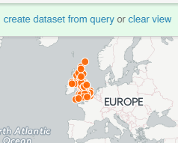
Expected Results
Click the SQL button again to hide the query window and observe the expected result
Slides 14-17 are voluntary; everybody has to work off slide 18 onward

Slide 14
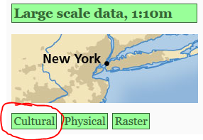
Voluntary Side-step (1)
If you want to access the same dataset by going to the original provider rather than CartoDB synching it once a month
Click on the little return button in the upper left corner to return to the CartoDB dashboard
Open a browser window and go to http://www.naturalearthdata.com/
Click on , then
“Large” scale cultural data
Scroll down to Populated Places

Slide 15
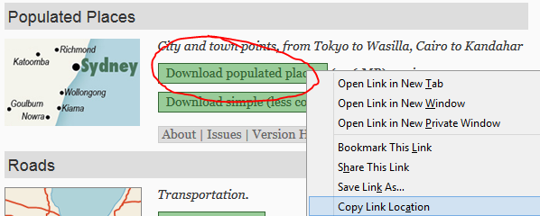
Voluntary Side-step (2)
Right-click the green Download populated places button and copy the link address
Now return to your CartoDB dashboard and click on
You will be prompted with many options to import your data from

Slide 16
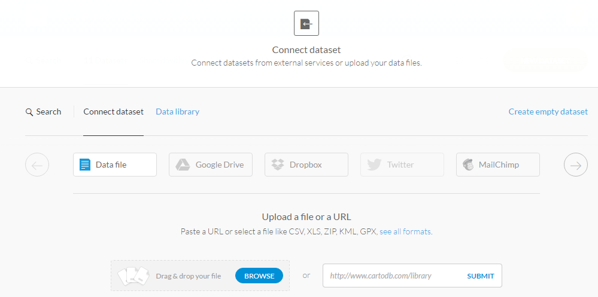
Ways to Import Data into CartoDB
Copy and paste the URL from the populated places dataset in Natural Earth

Slide 17
Ways to Import Data into CartoDB
You will see that the link is actually to a zip archive on the Natural Earth web site
Press the submit button
You will be prompted whether and how often CartoDB should check in the future about updates to the dataset
Leave it for now to the default ‘never’ and have CartoDB connect to the dataset
Actually, it downloads and unzips the archive to create a new PostGIS table of the shapefile

Slide 18
Import File from NYC Datamine
Go to the NYC Datamine
Type ‘community districts’ in the search window and press return
There are > 100 results but the first one works for us; click on that link the get a map of the community districts on your screen
Click the little export button and then on to download a zipped-up version of a shapefile of the NYC community districts

Slide 19
Importing a File
Go back to your CartoDB dashboard
Click on and
Either use your file to drag and drop the zip archive or click the Browse button to upload the zip archive to your CartoDB account

Slide 20
Importing a File
Click to have CartoDB upload, unzip, interpret and transform the shapefile into a PostGIS table

Slide 21
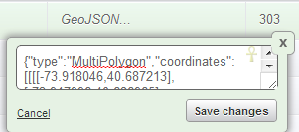
Polygons in a Database
Column #2 is the geometry; here it says Polygon
Double-click it to see the underlying GeoJSON* notation:
Scroll down to see the list of coordinates that the boundaries of the polygons that the CDs are made of consist of.
You can drag this little triangle
to enlarge the window and see the full sequence of coordinates
* Geo- Javascript Object Notation

Slide 22
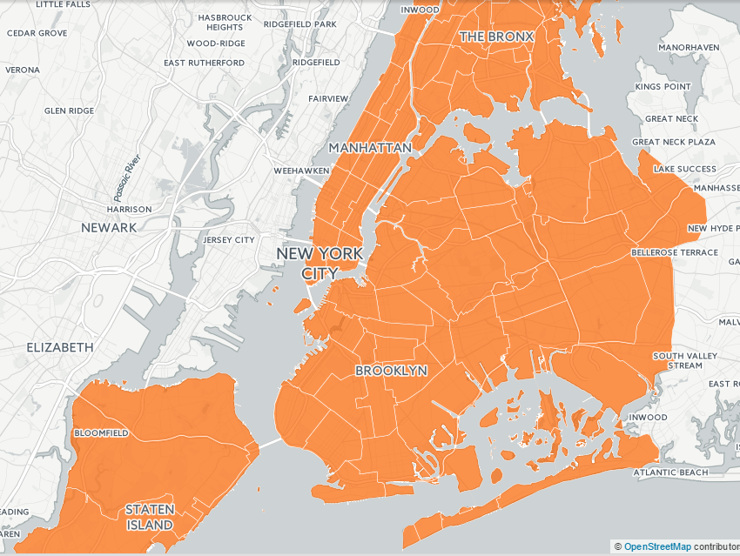
Switch to _______

Slide 23
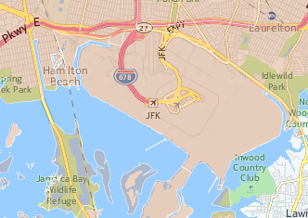
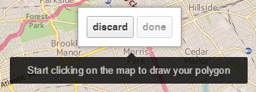
Add New Geographies
Zoom to an area of interest, say Inwood (south of JFK airport)
Let’s annex it for the city…
Click the Add Feature button at the bottom of the vertical tool menu

Slide 24
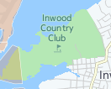
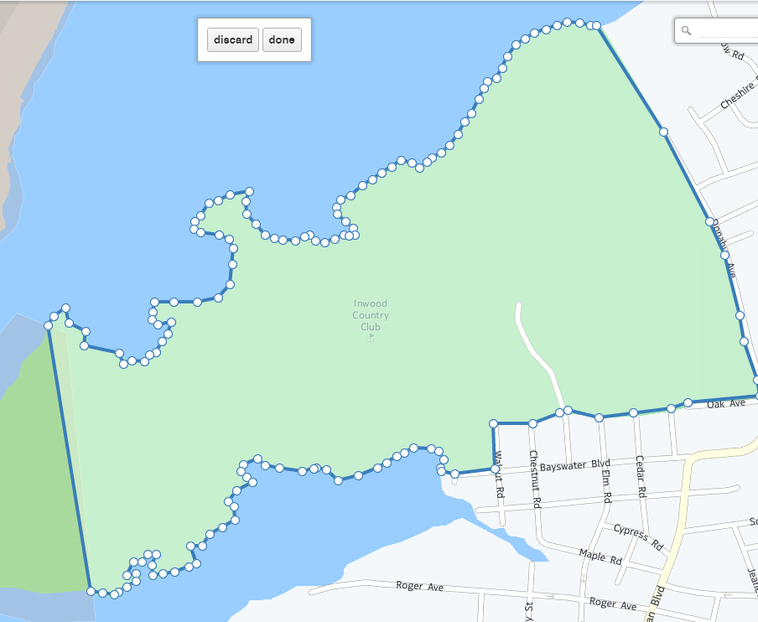
Add New Geographies (2)
Digitize the outline of the Inwood Country Club
End by double-clicking on first node a second time; then click “done”

Slide 25
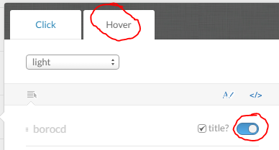
Add New Geographies (3)
Switch back to Data View and scroll down in the table until you find a row with NULL values for the last three columns
Double-click the null value in the borocd column to open the editor and enter the value ‘601’; then press
Switch back to Map View and click on the infowindow button
Click on the Hover tab and set the checkmark for ‘borocd’
When you now move the cursor over map elements, it will display the CD, including for the new one

Slide 26
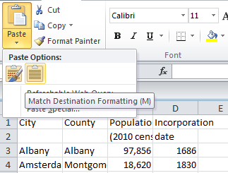
Screen-scraping
Copy and paste list of NY cities into Excel
Excel 2010: Match destination formatting
Remove extra characters
Items in [] or ()
Reduce NYC to one county (New York)
Make sure no field is empty
Save as Excel file and drag and drop into CartoDB

Slide 27
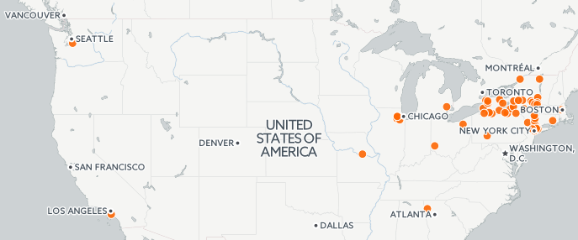
Checking the Results
Looking at PostGIS table - it looks good
But switching to Map View reveals problems
CartoDB automatically geocoded the cities and got quite a few wrong

Slide 28
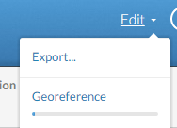
Getting Started with Geocoding
Let’s add a column that explicitly states that each city is in New York (state):
Click the add column button
Rename the new column ‘state’
Use SQL to fill all cell values of ‘state’ with ‘NY’
Now click on Edit in the upper right corner of the CartoDB window and then on Georeference to embark on an interactive geocoding procedure

Slide 29
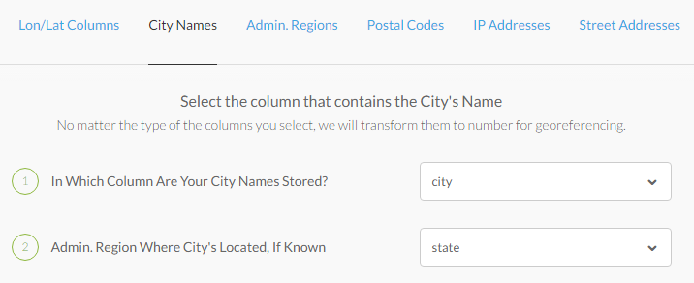
Geocoding Options
You are given six different ways to georeference your data
Chose City Names as the geocoding type and fill in the required information;
Then accept that you are geocoding point features

Slide 30
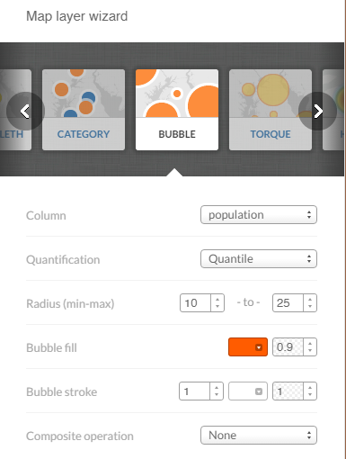
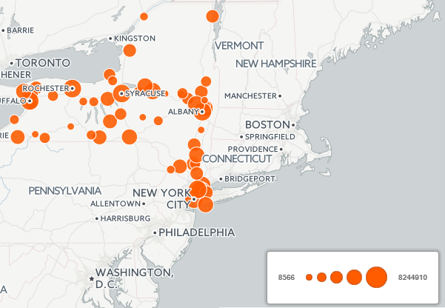
Change Data Type to Create Bubble Map
Click on the visualization wizard
Scroll to the right inside the wizard window to select a map of type “bubble”
Select column ‘population’
Leave all other options at their default values

Slide 31
Tax Havens
Download and clean the Excel file of tax havens similar to what your did with NY cities.
Upload the cleaned file to CartoDB and create a bubble map of the secrecy score (fsi_value4)
Click the button in the upper right corner of your CartoDB browser page
Accept the
Prettify the map (zoom level, title, colors, etc.) and your map

Slide 32
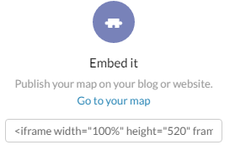
Share Your Work (1)
In order to share your work, you need a website that you can actually edit
You are at complete liberty what web site service you want to use;
One option is Google Sites
If you already have your own site, use that one
Otherwise create a new home page for yourself which you will use from now on as your professional portfolio page
Add your map by using the CartoDB link

Slide 33
NYC Election Map
Data from http://projects.iq.harvard.edu/eda/
Scroll down to New York and download the zipped shapefile and the metadata in .rtf format
Have a look at metadata
This data set is too big for the free version of CartoDB
So let’s load it into QGIS to extract just Manhattan (or a borough of your choice)

Slide 34
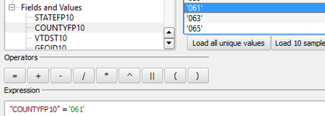
NYC Election Map
Load the ny_final shapefile that you just downloaded into QGIS
Open its attribute table and select features using an expression
Select Manhattan (FIPS County ‘061’)
Close the attribute table and Save Selection As a new shape file called Mhelect.shp

Slide 35
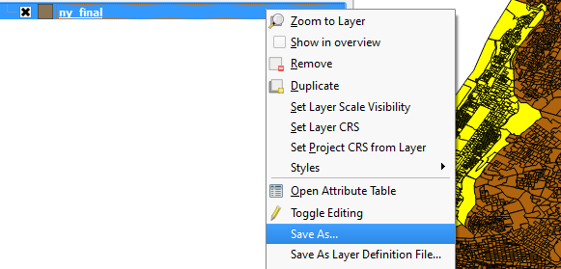
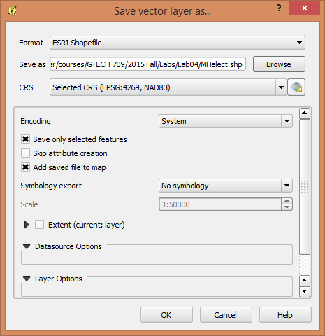

Slide 36
NYC Election Map
Create a ZIP archive of your Manhattan election districts and drag that into the new table dialog of CartoDB
Have a look at metadata that you downloaded in .rtf format
Display “av” field as a choropleth map
blue color range, 7 buckets, 70% opacity)
Custom[ize] what gets displayed when you use the Identify tool to show "av" only
Still some unsatisfying areas like Central Park (check its value with Identify tool)

Slide 37
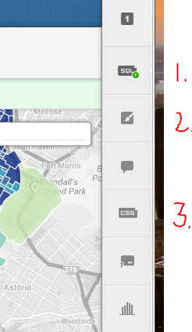
NYC Election Map (2)
Limit your visualization to only those records that have people living in them
Click the SQL button to create a custom query
SELECT * FROM mhelect WHERE total > 0
Redo the choropleth map from the previous slide – but then
Click the resulting CSS style sheet, go to the last line that says polygon-fill and replace the hex value with the word red
Make map Public and share it

Slide 38
Homework (graded)
Display a map of NYC parking spots in CartoDB;
Search the NYC datamine for parking data from the Department of Consumer Affairs
Export the map contents to a .csv file (!)
Filter for parking lots with > 1,000 spaces;
Load the data into CartoDB and georeferenced the < 30 records if necessary;
Make it public and share it by entering the URL in your BlackBoard submission
Publish and share your NYC voting map
Publish and share your tax havens map
Create a completely new map in CartoDB with a variable of your choice from a web site not in these instructions
Extra points for exotic/interesting data source and sophistication of your visualization
Again, share its URL via BlackBoard

